Slide 1


Supporting Nebraskans
with Intellectual and Developmental Disabilities to Join the Workforce and
Contribute to Nebraska’s Economy
Presentation on Study Conducted by Moving To A Different Drum, LLC
Dr. Lisa A. Mills, PhD
March 2023
Study funded by the Nebraska Council on Developmental Disabilities

Slide 2
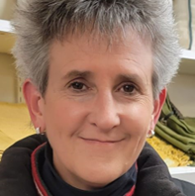

Today’s Presenter:
Dr. Lisa Mills, PhD
Consultant to state and federal agencies on how
to advance competitive integrated employment for
individuals with disabilities
32 years in field –primarily focused on individuals with IDD
Expertise in Medicaid waivers, Customized Employment, and value/outcome-based reimbursement models for supported employment services
Lives in Wisconsin; has worked in more than 20 states including Colorado, Iowa, Kansas, Michigan, Ohio, Oregon, Washington, Tennessee, Maine

Slide 3
Nebraska Developmental Disabilities Council’s 1st Goal
2022-2026 Five-Year State Plan Goals and Objectives
Goal 1. The Nebraska Council on Developmental Disabilities (DD) will collaborate with Nebraska DD Network Partners, state agencies, community programs, and other stakeholders to provide resources and improve competitive, integrated, and meaningful opportunities for employment, including self-employment with competitive wages, for Nebraskans with intellectual and developmental disabilities (I/DD) from diverse locations and identities.
Objective A. By 2026, increase awareness, knowledge, and identify necessary system changes to remove barriers to competitive, integrated employment at a living wage for individuals with I/DD.
Objective B. By 2026, increase resources, access, options, and opportunities for competitive employment to support the Nebraska Employment First Initiative and work with policymakers to have Nebraska declared an Employment First State.

Slide 4

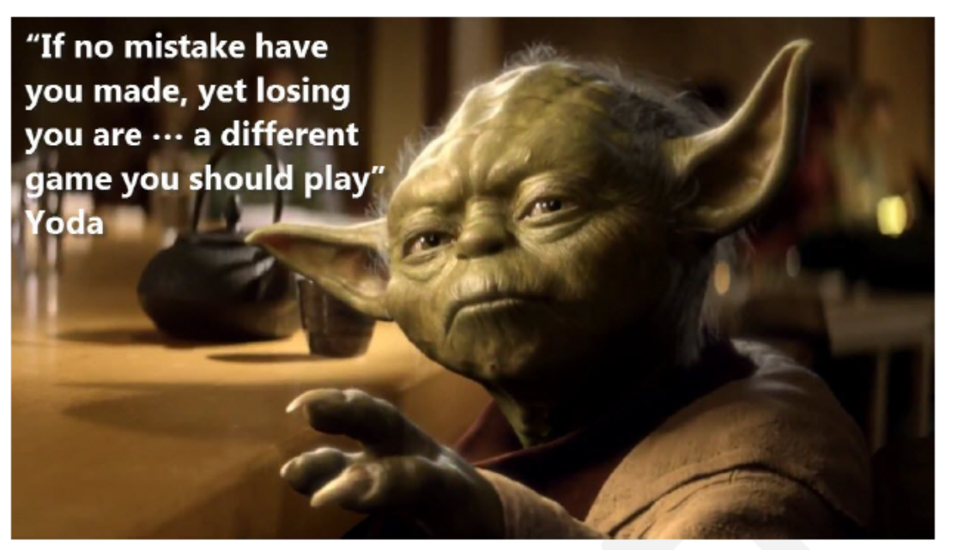
Why a Study is a Good Idea?
Learning from history
Evaluating the current situation
Demonstrating positive outcomes
Seeing untapped opportunities
Recognizing areas of consensus
Clarity about how barriers
could be tackled
You can’t really know where you are going until you know where you have been.
-Maya Angelou

Slide 5

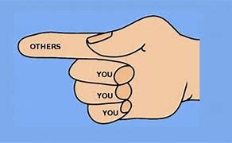
Progress Requires Setting Aside the Blame Game
Always Remember…
When you point a finger at someone else, there are always three fingers pointing back at you.
Challenges in our field too often cause us to turn on each other.

Slide 6
If We Are Polarized, Our Work is Fragmented and Siloed.
We can make more progress working together as compared to working separately.
Coordination of effort requires intentional and active collaboration… AND the allocation of resources necessary for this collaboration
Resources: leadership time; human; financial; systems; etc.
What justifies allocating resources to the goal increasing competitive integrated employment participation among people with IDD?

Slide 7
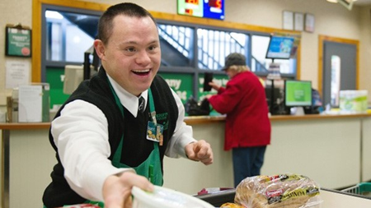

Governor Jim Pillen’s Proclamation
March 21, 2023
March is Developmental Disabilities Awareness Month. Individuals with developmental or intellectual disabilities are made in the image of God and their disability is a natural part of the human experience and does not diminish their human dignity.
Nebraska encourages and supports the employment of individuals with developmental or intellectual disabilities because it is beneficial for individuals and beneficial for Nebraska employers. Businesses can expand their talent pool, strengthen their workforce by creating a welcoming and supportive workplace, and increase their overall bottom line.
Nebraska seeks to provide opportunities for our citizens with intellectual and developmental disabilities to advocate for themselves and to receive the supports they need to be productive, successful, and independent members of their communities.
These individuals should be seen as contributing neighbors, co-workers, church members, classmates, voters, friends, volunteers, and valued members of our community.

Slide 8

Why is Competitive Integrated Employment So Important?
NEBRASKA
PEOPLE WITH IDD
PUBLIC SERVICES
Shrinking workforce
Record low unemployment
Labor force projections indicate long-term problem
Nebraska’s economic growth limited by lack of workforce
Businesses that embrace diversity are better positioned for success going forward.
Benefit from feeling capable, a sense of purpose and a sense of accomplishment
Need for opportunities that utilize natural community settings and engage the broader community.
  Community members as role models for participation, interaction
  Opportunity to learn, practice and use skills to benefit self and others
Benefit from opportunities to hold valued social roles, changing fellow community members’ perceptions
Need ways to address poverty
Direct service workforce shortage
  Increased congregation and segregation is not the answer.
Adequate funding more likely if tied to return on investment
Expectation of publicly funded programs
Notes:
Continuing to support people in traditional models of service is no longer sustainable
New, viable support models utilize natural community settings (where natural supports can be engaged), effective skills training, technology and adaptive devices.

Slide 9
Why is Competitive Integrated Employment So Hard to Facilitate?
Study Findings: Barriers to Increasing CIE Participation
The perception of people with IDD in the broader community and among Nebraskan employers
Expectations of people with IDD within publicly funded service systems that serve people with IDD
Lack of effective strategies in person-centered planning for individuals with IDD and their families/guardians to facilitate informed choice about competitive integrated employment
No clear incentives but clear disincentives for Nebraskans with IDD to choose competitive integrated employment

Slide 10
Why is Competitive Integrated Employment So Hard to Facilitate? (2)
Study Findings: Barriers to Increasing CIE Participation
Historically restrictive policies governing the availability and provision of Supported Employment services, with some key restrictions still remaining
The blurry intersection of Vocational Rehabilitation (VR) and Medicaid waivers in the provision of Supported Employment services to people with IDD
Implementation of Supported Employment services does not always follow best practices
Perceptions about the cost of Supported Employment and its lack of cost-effectiveness as a service option for people with IDD

Slide 11
A Word on Cost-Effectiveness
In human services, cost-effectiveness is not defined simply by comparing costs and determining which service costs the least.
Instead, cost-effectiveness is defined based on an analysis of both the comparative costs and comparative outcomes of one or more services.
The goal is to identify which services offer maximum health and quality of life gains for the cost associated with the service.
“Cheap” is defined as something low in price.
“Penny-wise and pound-foolish” means choosing cheap ended up costing more in long run.
Notes:
Source: See: https://www.cdc.gov/policy/polaris/economics/cost-effectiveness/index.html retrieved December 2, 2022.

Slide 12
Measuring the Cost-Effectiveness of Current Supported Employment Services
Collected data during two sample 4-week periods in spring of 2022.
Asked Supported Employment service providers to report data for individuals with IDD or Autism working in competitive integrated employment as defined in WIOA
Seven provider organizations participated.
Data reported on 234 distinct individuals working in 252 unique jobs.
84% eligible for or enrolled in one of the DDD Medicaid Waivers, with ISP not indicating constant supervision required.
Sample is roughly 25% of individuals with IDD currently working in CIE.* Sample deemed sufficient to draw broader conclusions.
*Source: National Core Indicators (2020-21 Adult In-Person Survey)

Slide 13
Major Findings of the Study:
Cost-Effectiveness of Current Supported Employment Services
194 Supported Employees with IDD worked a total of over 12,000 hours during the 8-week reporting period
On average, individuals received job coaching 43.7% of the time they worked.
Cost of an individual spending an hour working in individualized competitive integrated employment = $25.84
Based on Medicaid Waiver Supported Employment-Individual Rate (Effective 7/1/22) of $59.12/hour of service.
Achieved through service delivery by staff with no specific training requirements focused on evidence-based Supported Employment service delivery.
Achieved with service delivery payment structure that has minimal if any incentive for providers to reduce the unnecessary provision of job coaching
What could be possible if job coaches had training on evidence-based practices and if the payment structure incentivized and rewarded providers for reducing unnecessary provision of job coaching?
Notes:
78,000 hours/year; average of 8 hours/week

Slide 14

Despite Workforce Shortage, Incentive to Fade Appears Missing
Average cost of an individual spending an hour working in individualized competitive integrated employment = $25.84
Phase of Employment | Jobs | Supported Employee Total Paid Hours | Total Hours Coached | Coaching Level | Cost Per Hour of Paid Supported Employment*
0-11 Months | 60 | 3649 | 1908 | 52% | $30.74
12-24 Months | 42 | 2805 | 889 | 32% | $18.92
25+ Months | 103 | 5332 | 2506 | 47% | $27.79
Unknown | 6 | 431 | 34 | 8% | $4.73
Grand Total | 211 | 12218 | 5337 | 43.7% | $25.84
What could be possible if job coaches had training to ensure use of evidence-based practices and if the payment structure incentivized and rewarded providers for reducing unnecessary provision of job coaching?

Slide 15
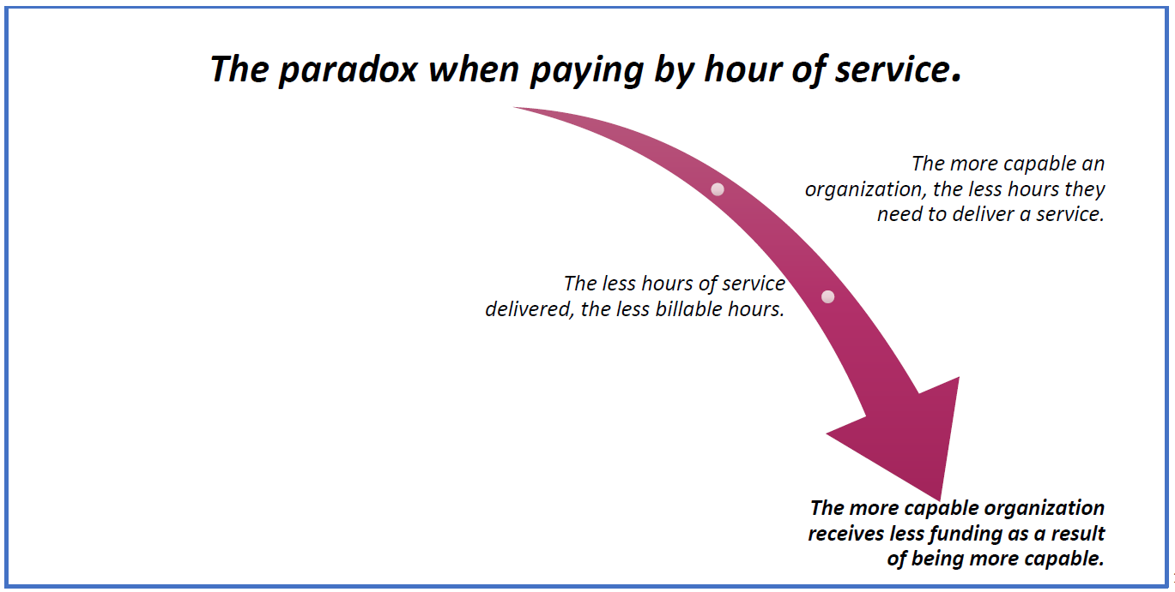
The Implications of Fee-for-Service Payment Model

Slide 16
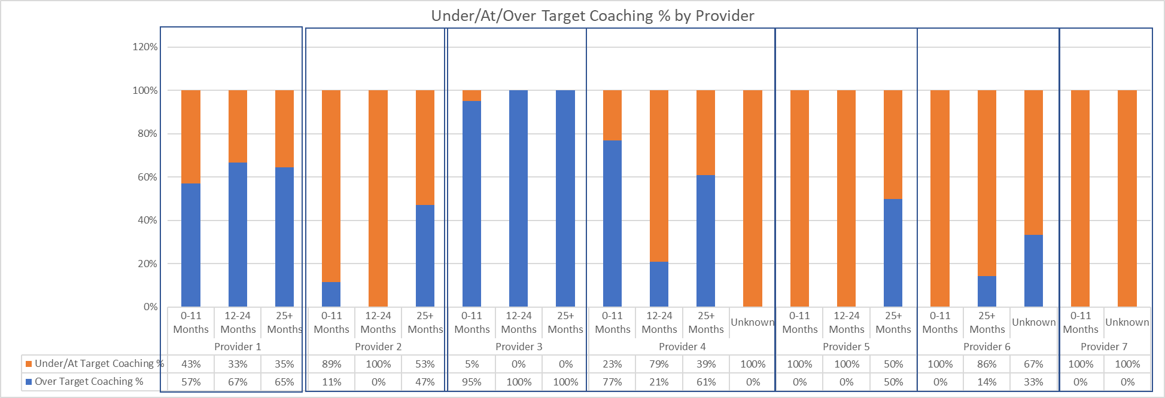
Study Findings:
Current Provider Performance Varies
= Coaching more than target level.
= Coaching less than target level.

Slide 17

Developing Alternative Payment Methods
Requires Us to See Things Differently
It can be challenging to set aside historical approaches to paying for services
Developing better payment methods requires brainstorming, fresh ideas, and setting aside how things work now

Slide 18
Major Study Conclusions
Supported Employment is under-utilized by people with IDD for multiple reasons.
The history of Supported Employment services in Nebraska is not significantly different from other states.
One significant difference is Nebraska’s history does not yet include a truly comprehensive, intentional and visible effort involving key state agencies and key stakeholder partners acting together on a comprehensive shared plan, using resources of all partners in a coordinated way.

Slide 19
Major Study Conclusions (2)
Nebraska has a significant opportunity at this particular point in history because:
  The positive relationships between leadership and staff in the key state agencies.
  An unprecedented need and opportunity for individuals with IDD to join the general workforce.
  The availability of Supported Employment services that, with key changes to improve access, effectiveness, and to further improve cost-effectiveness, could deliver the improved outcomes desired.

Slide 20
Study Recommendations
Develop a collaborative plan among all key partners to more strongly and intentionally promote, to employers and the general public, the value of individuals with IDD as members of Nebraska’s workforce.
Stakeholders, with leadership from key state agencies and other organizations, should collectively seek the new Governor’s (continued and increased) involvement in promoting the value of individuals with IDD as members of Nebraska’s workforce with Nebraska’s business and industry groups and employers.
Advance the State of Nebraska as a model employer, by intentionally developing competitive integrated employment opportunities for people with disabilities including people with IDD.

Slide 21

Study Recommendations (2)
Nebraska VR And DDD should update and expand their current memorandum of understanding (MOU).
Ensure uninhibited access to publicly funded Medicaid HCBS Waiver Supported Employment services for eligible individuals with IDD, when the needed service(s) are not timely available through Nebraska VR (or if a student is still in high school, through special education services funded under IDEA).
Promote uninhibited, equitable access to publicly funded Vocational Rehabilitation Supported Employment Services by people with ID/DD

Slide 22
Study Recommendations (3)
Public funders of Supported Employment services should collaborate to ensure effective Supported Employment practices by implementing competency-based qualification and/or training expectations for staff delivering Supported Employment services.
Reach youth with IDD early, focus on increasing competitive integrated employment (CIE) post-secondary outcomes in Individualized Educational Plans, and promote the use of peer mentors to seed the expectation of a working life in adulthood
Identify available short-term funding that can be invested in the provider network and workforce which can support increased opportunities for competitive integrated employment for people with IDD

Slide 23
Study Recommendations (4)
Engage key informants for this study in a one-day summit to discuss this study’s findings and recommendations, and determine what consensus can be reached about how a collaborative initiative could move forward to increase competitive integrated employment outcomes for Nebraskans with IDD
Maintain commitment to evolving the comprehensive strategy over time.

Slide 24
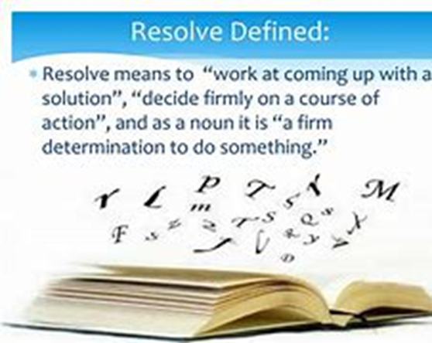
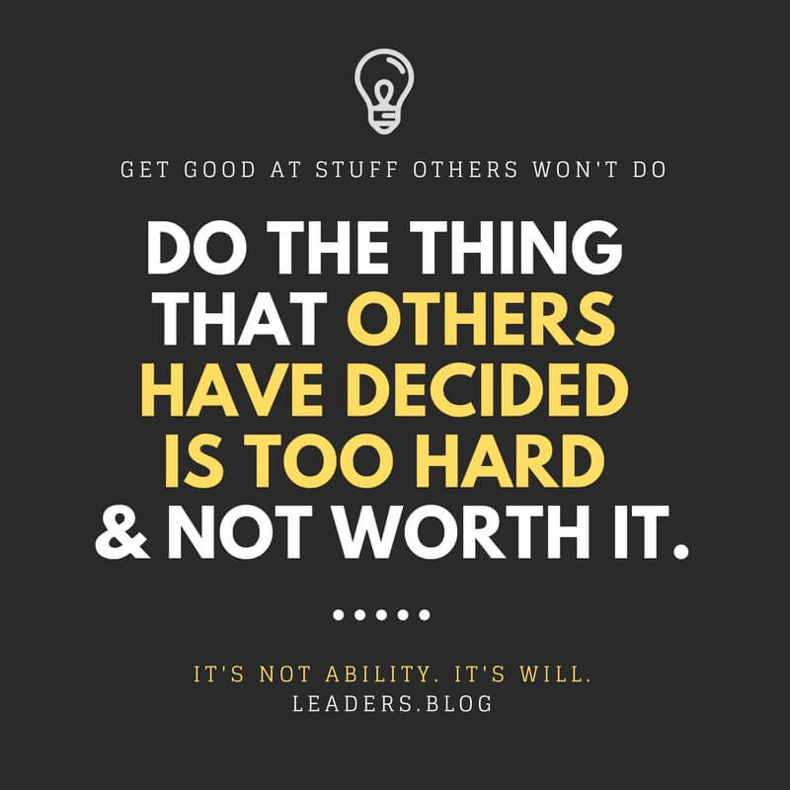
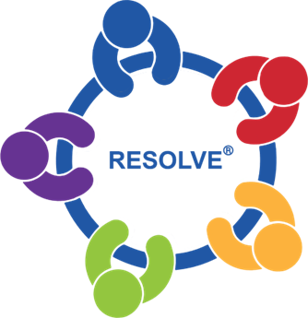

Slide 25
Acting Together: Work to Avoid Bad Traits of Teams
      Not paying attention to results
      Nobody taking responsibility
      Lack of commitment
      Fear of conflict
      No trust
Source: Working Better Together: Embracing Good Conflict and Solving Bad Conflict
© 2017 Autistic Self-Advocacy Network
Working-Better-Together-Embracing-Good-Conflict-and-Solving-Bad-Conflict.pdf (d3r5ngmnz0b984.cloudfront.net)

Slide 26
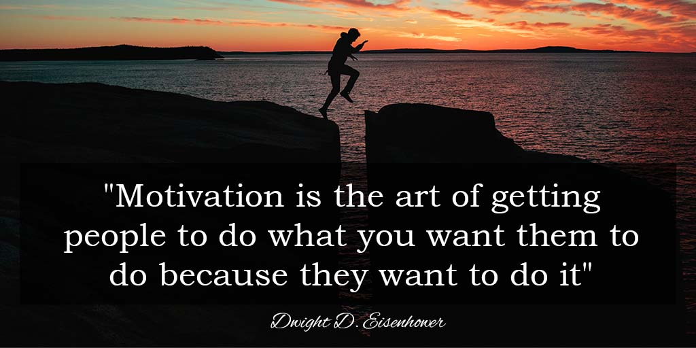
Are We Really Engaging People with IDD with the Intent to Motivate Them to Work?

Slide 27

Encouraging People with IDD to Consider and Pursue Work
Are we doing more than infrequently asking a few questions?
Are we effectively involving families/guardians, if present?
Is the opportunity to consider working being offered in a way people can understand what’s being offered?
Are we supporting truly informed choice?
Are we actively trying to dispel myths?
Have we set goals to increase interest?

Slide 28
Questions?
Comments

Slide 29
Presenter Contact Information:
Lisa A. Mills, PhD
Moving To A Different Drum LLC
lisamills@mtdd.onmicrosoft.com
608 225 4326

